Slide 1
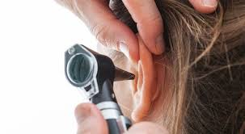
Otoscopy

Slide 2
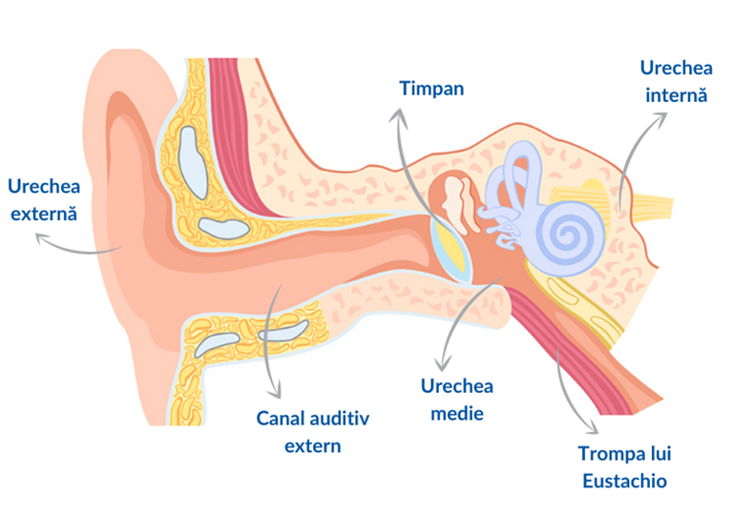
The ear, an organ of hearing and balance, can be anatomically and clinically divided into:
the outer ear
the middle ear
the inner ear

Slide 3
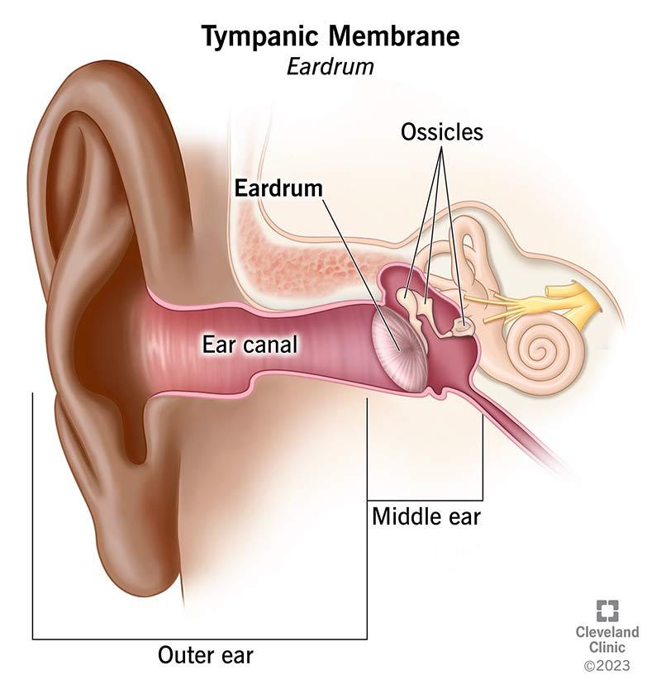
Outer ear
It is made up of the auricle (pinna) and the external auditory canal (E.A.C.), and is separated from the middle ear by the tympanic membrane.

Slide 4
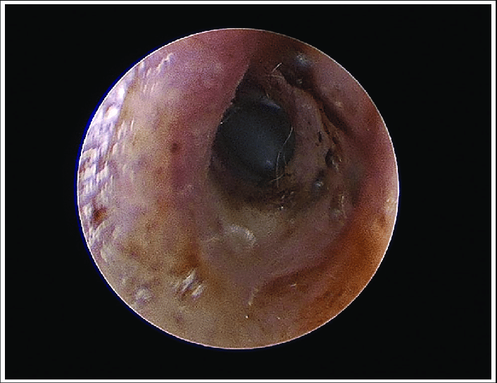
External auditory canal (E.A.C.)
It has an external fibrocartilaginous portion and an internal bony portion, with the narrowest area, called the isthmus, located at their junction.
In the subcutaneous tissue of the cartilaginous portion, there are pilosebaceous follicles and ceruminous glands, which secrete a yellowish-brown substance called cerumen (earwax).

Slide 5
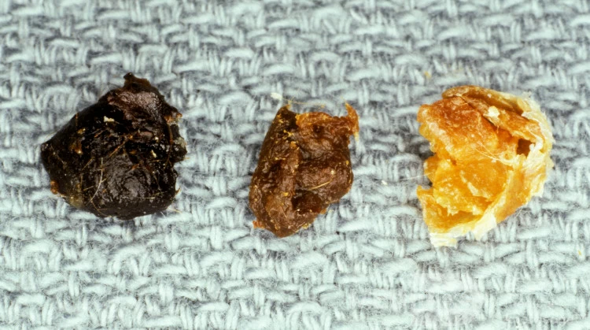
Cerumen
A protective and self-cleaning role for the tympanic membrane and the skin of the canal

Slide 6
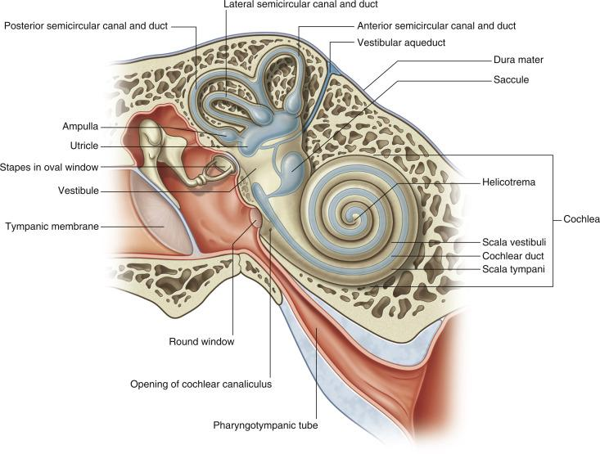
Middle ear
The middle ear is a system of air-filled cavities, carved into the temporal bone and lined with mucosa.
It consists of:
the tympanic cavity
the mastoid air cells
the Eustachian tube

Slide 7
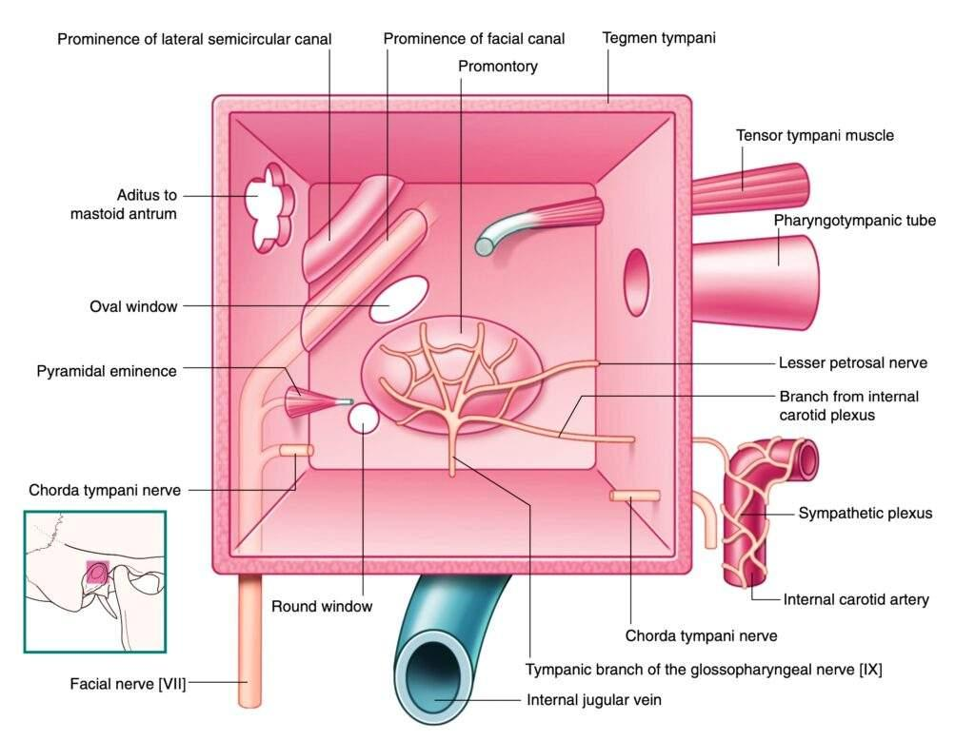

Slide 8
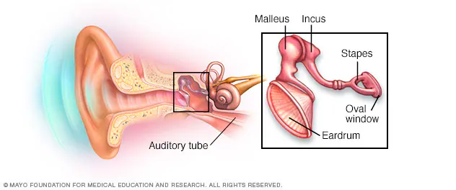

Slide 9
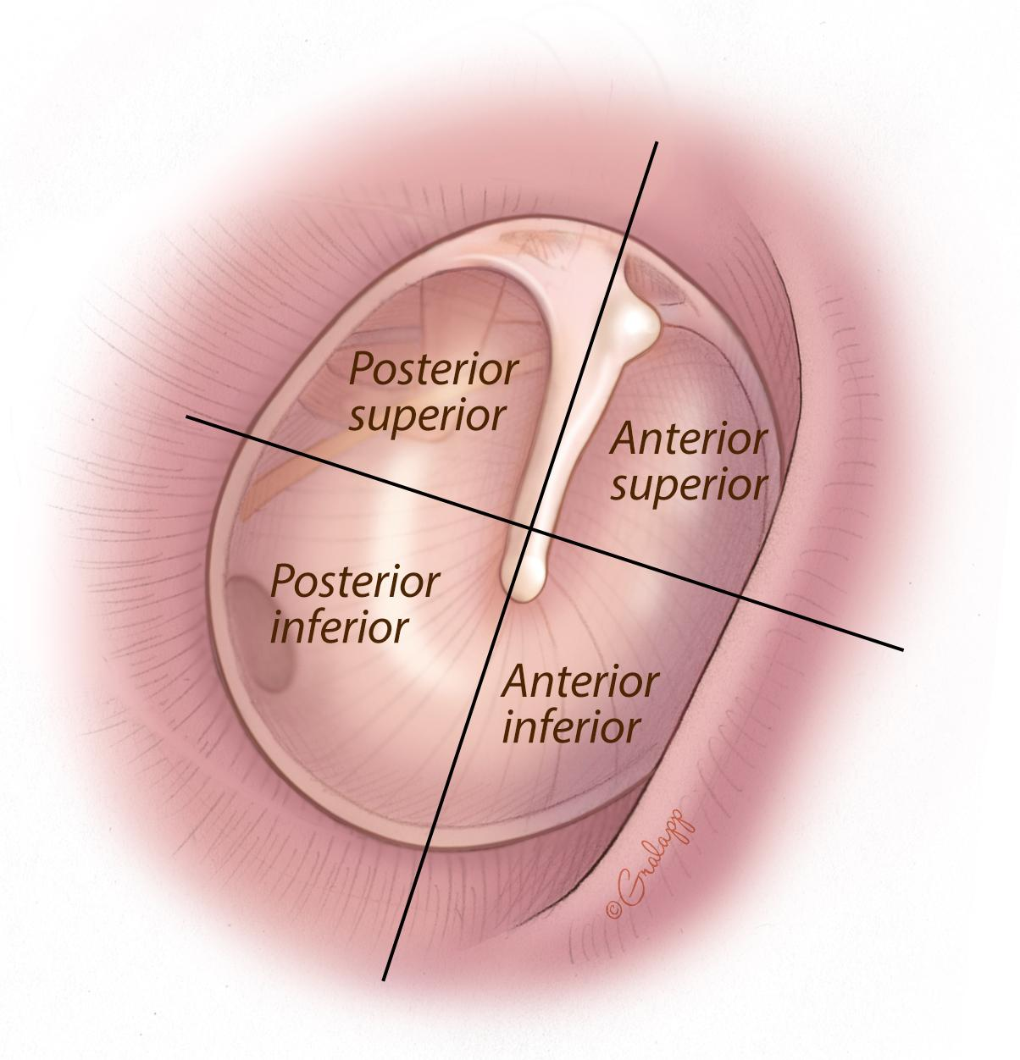

Slide 10
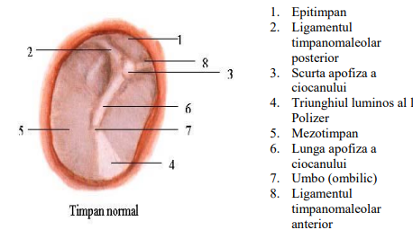
Membrana Timpanica

Slide 11
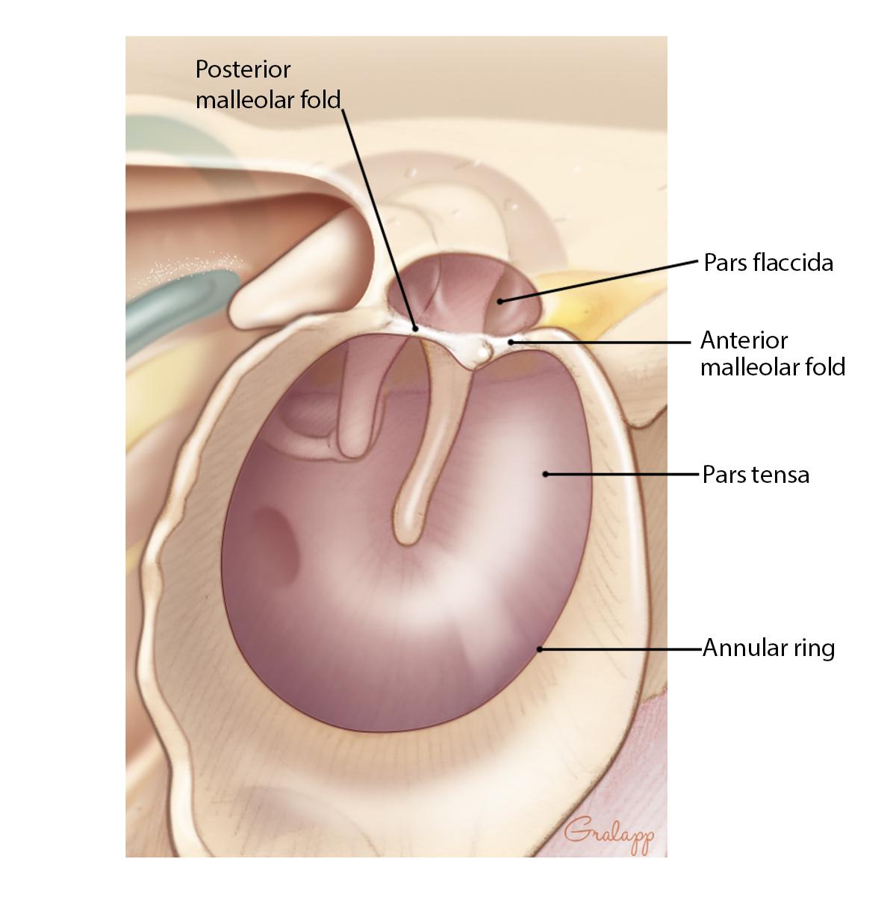
Tympanic membrane – Pars Tensa
An outer cutaneous layer, continuous with the skin of the external auditory canal (E.A.C.)
A middle fibrous layer, composed of radial and circular fibers, forming the vibrating framework of the tympanic membrane, known as the lamina propria
An inner mucosal layer, which is the mucosa of the middle ear

Slide 12
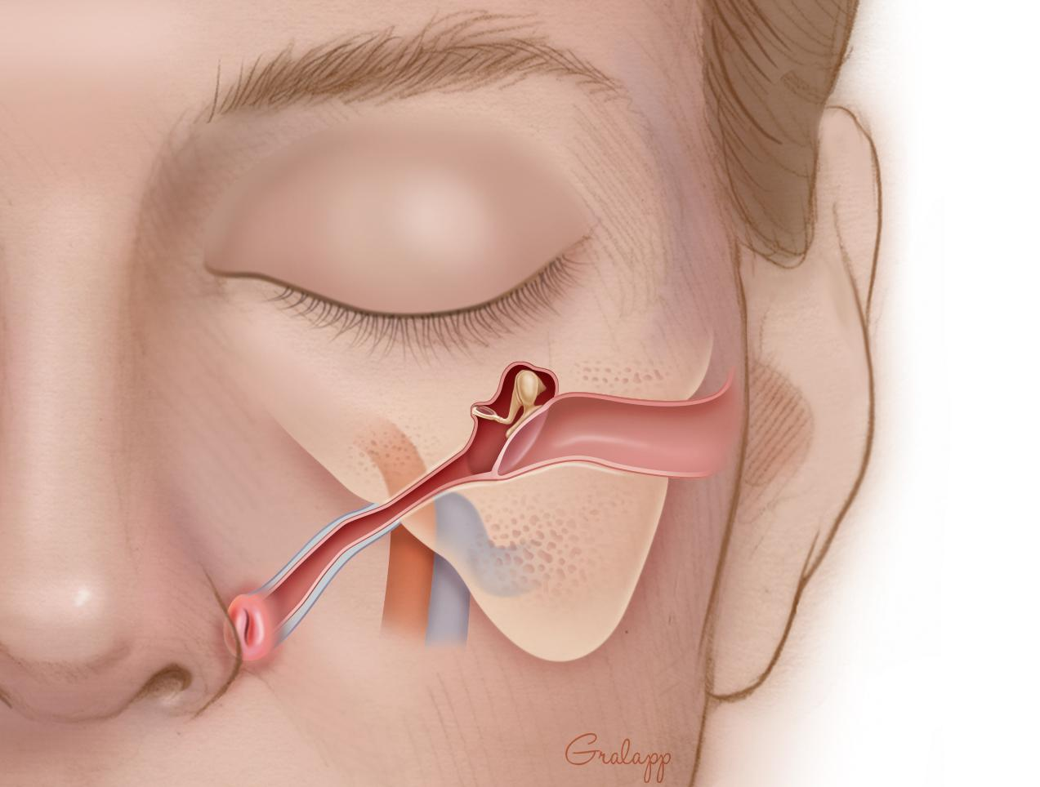
Eustachian tube
It connects the tympanic cavity with the nasopharynx.
It consists of two parts:
a bony portion, carved into the temporal bone
a fibrocartilaginous portion, forming a virtual canal that opens during each act of swallowing

Slide 13
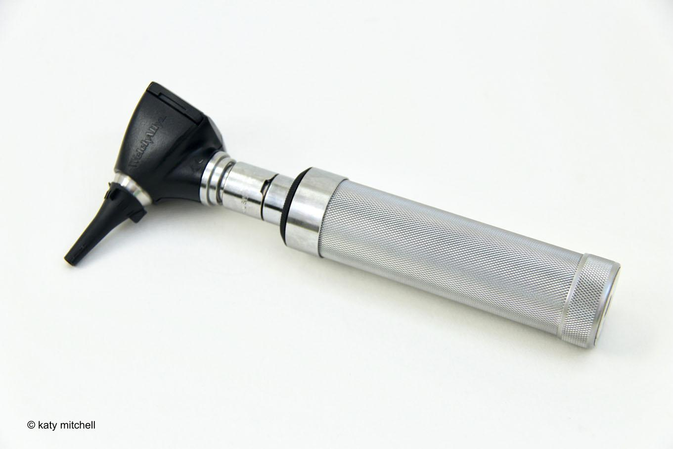
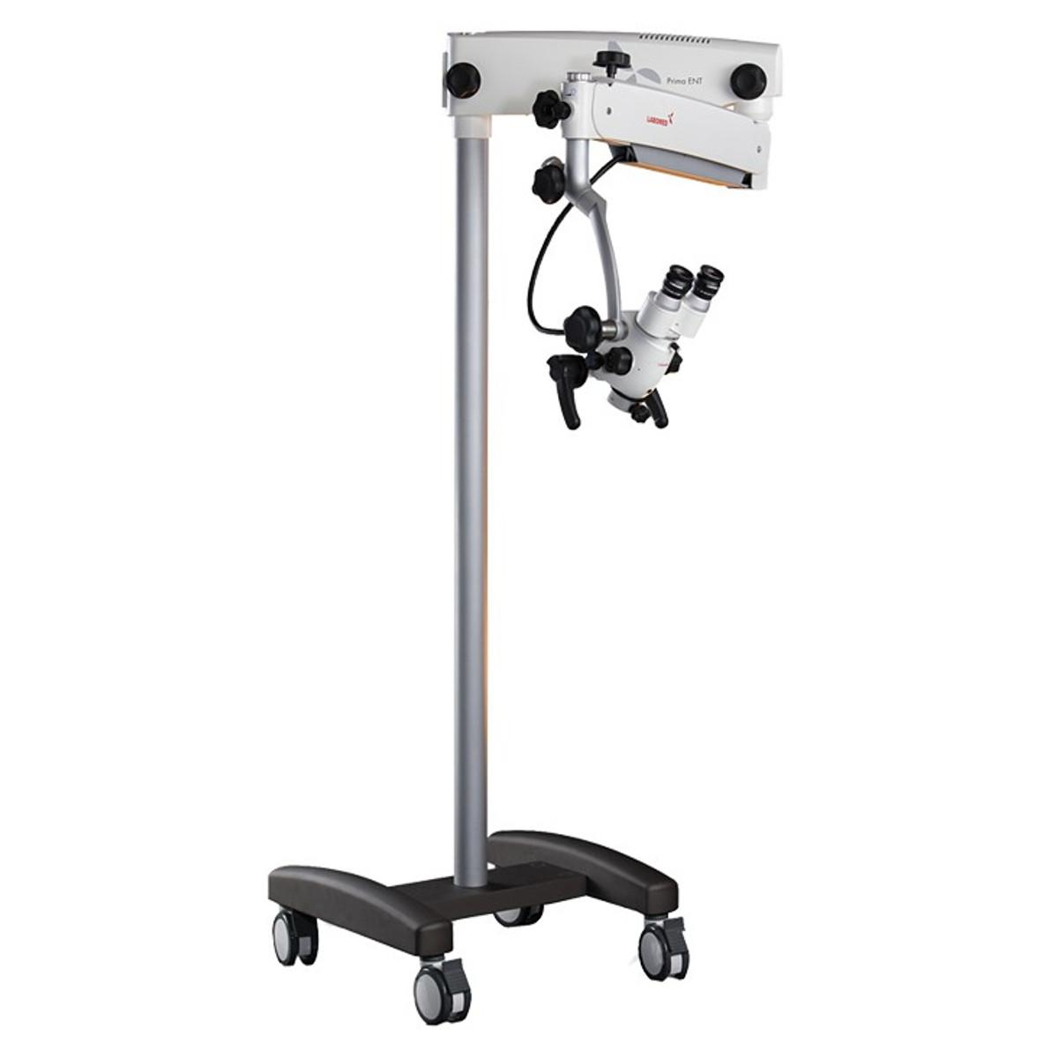
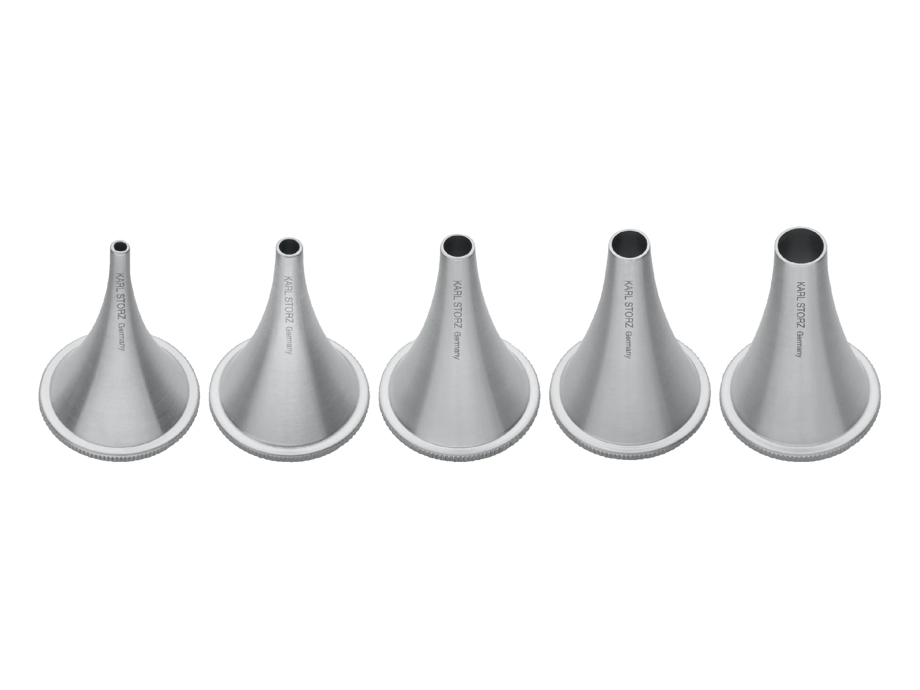

Slide 14
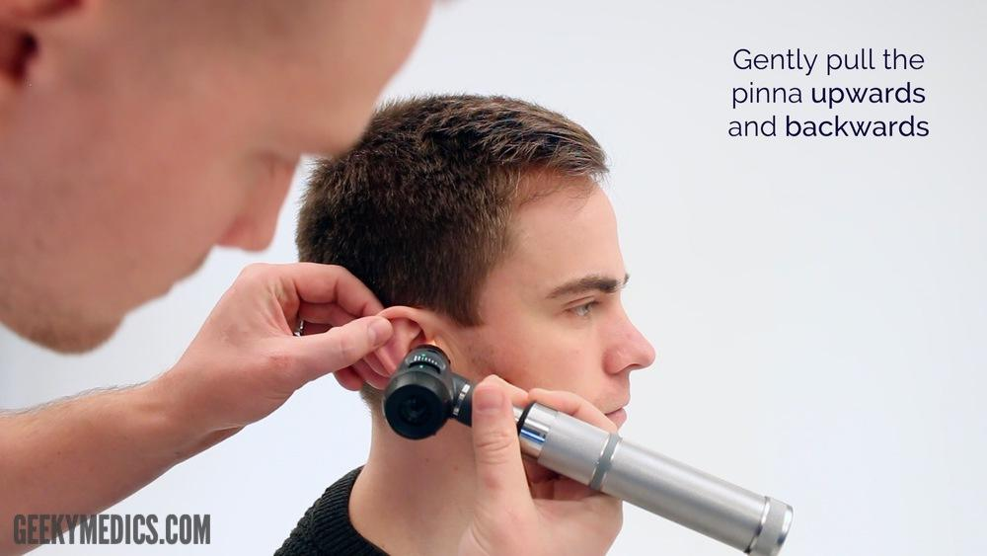
1)The otoscope is held like a pen.
With the other hand, pull the auricle:
In adults: upward and backward
In children: downward and backward
2)Gently insert the speculum without forcing.
3)Examine:
The auditory canal (appearance, cerumen, foreign body)
The tympanic membrane (color, transparency, cone of light)

Slide 15
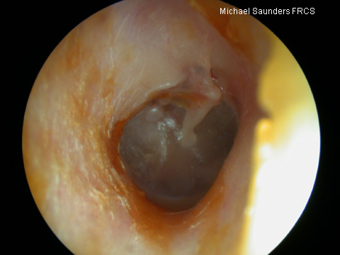
Normal aspects
External auditory canal (E.A.C.):
Color: pale pink, clean
Walls: smooth, without inflammation or discharge
May contain a small amount of cerumen (wax), but not in excess

Slide 16
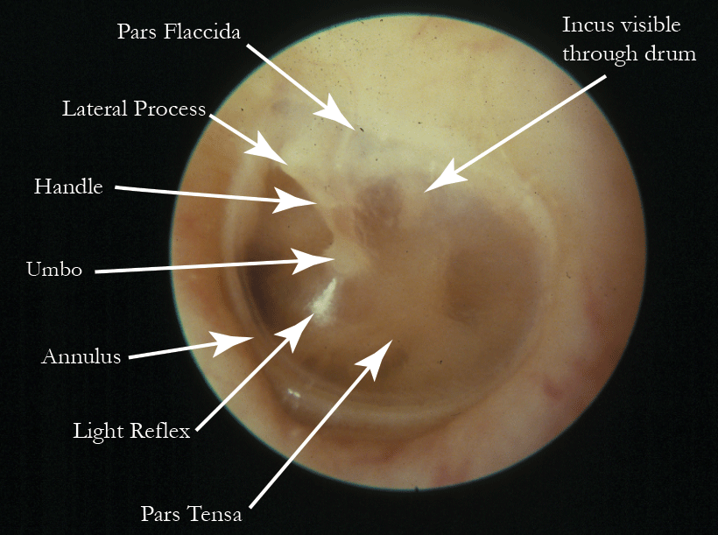
Tympanic membrane
Color: pearly gray or slightly transparent
Position: slightly concave (pulled inward)
Mobility: present (sometimes checked by air insufflation – Valsalva test)
Visible landmarks:
Handle of the malleus (appears as a whitish streak)
Umbo – the central point of the tympanic membrane
Cone of light – a triangular reflection in the anteroinferior quadrant (bottom right for the right ear, bottom left for the left ear)

Slide 17
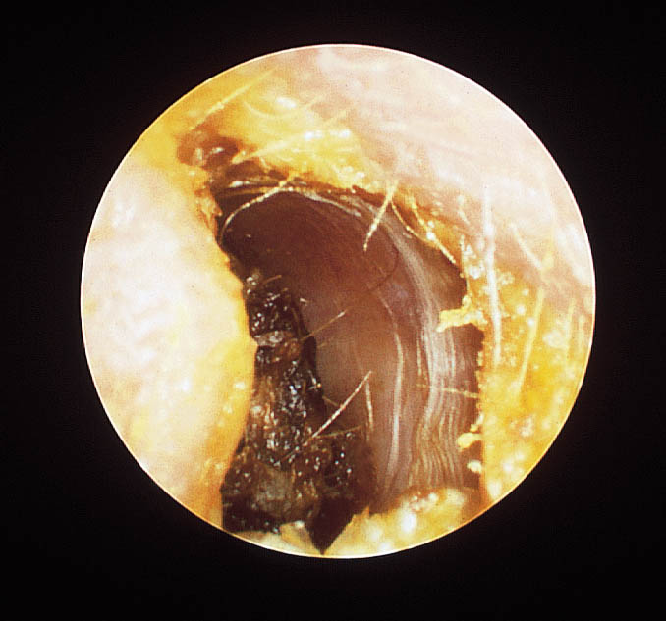
Earwax plug

Slide 18
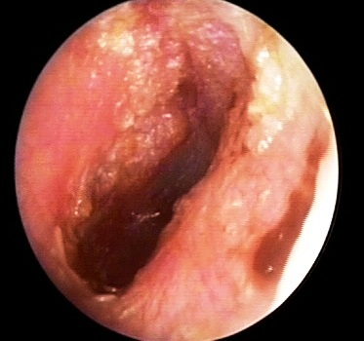
Otitis externa

Slide 19
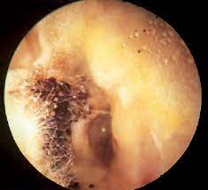
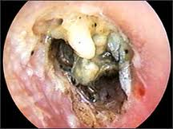
Otomycosis

Slide 20
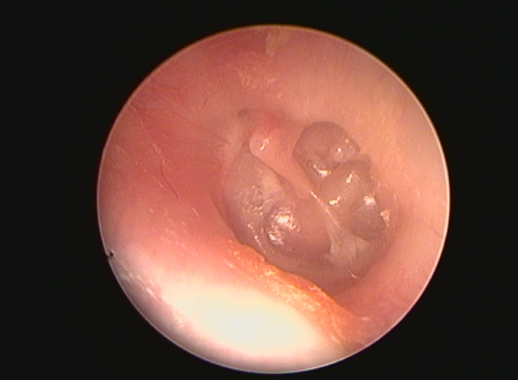
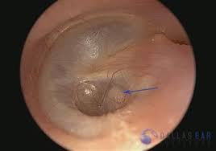
Tympanic membrane retraction

Slide 21
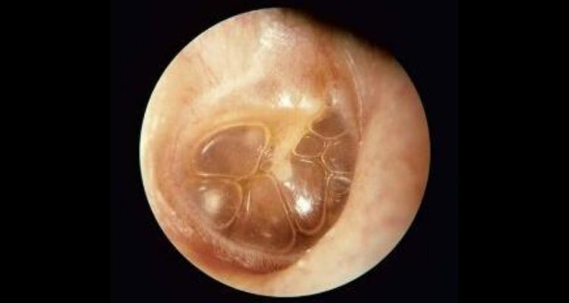
Otitis media with effusion (serous)

Slide 22
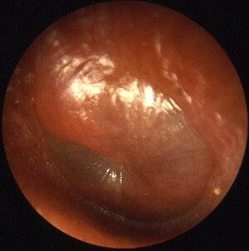
Acute otitis media

Slide 23
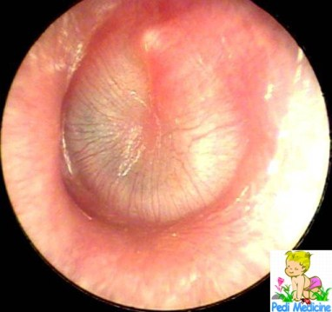
Acute suppurative otitis media (pre-perforation stage)

Slide 24
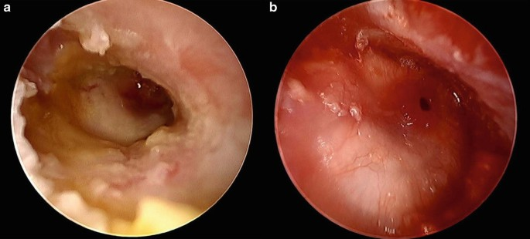
Acute suppurative otitis media (perforation stage)

Slide 25
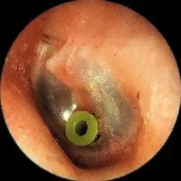
Ventilation tubes for transtympanic drainage

Slide 26
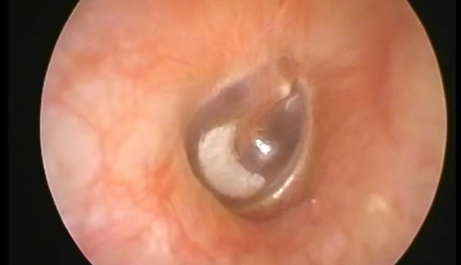
Myringosclerosis

Slide 27
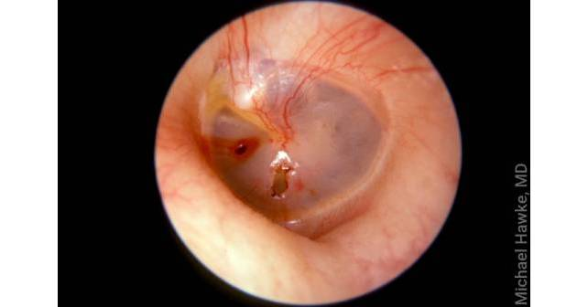
Barotrauma

Slide 28
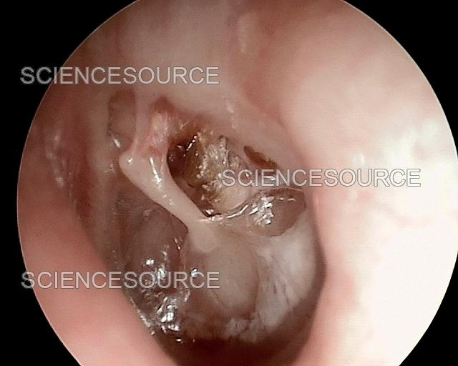
Cholesteatoma

Slide 29
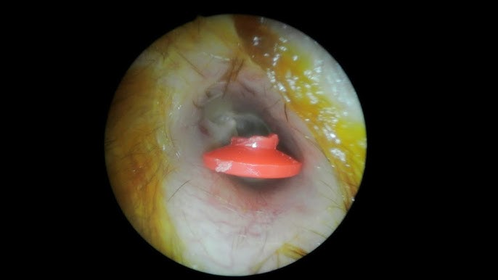
Ear foreign bodies

